Slide 1
Bullish Candlestick for Shriram Finances
A presentation exploring Bullish Candlestick trends for Shriram Finances.
Prepared for business review and technical insight.
Prepared by Bansari Mehta Roll no: SDAF052D

Slide 2
Introduction to Shriram Finance
Shriram Finance is one of India’s leading non-banking financial companies (NBFCs), formed after the merger of Shriram Transport Finance Company and Shriram City Union Finance. It primarily
focuses on providing financial services to underserved and
SME
unbanked segments, including commercial vehicle loans,
financing, personal loans, and gold loans. With a strong rural and semi-urban presence, Shriram Finance aims to empower small entrepreneurs and individuals by offering accessible and affordable credit solutions. Its customer-centric approach and widespread network make it a key player in India's financial services sector.

Slide 3
Technical Overview of Shriram Finances
Shriram Finance operates a vertically integrated business model, offering a diverse range of financial products, including:
Pre-owned and new commercial vehicle loans.
Two-wheeler and passenger vehicle financing.
Tractor and farm equipment loans.
Gold loans.
Personal loans.
Micro, Small, and Medium Enterprises (MSME) financing.
Working capital loans.

Slide 4
Technical Indicators Signaling Bullish Trends
Moving Averages (SMA/EMA)
RSI and MACD
Bollinger Bands

Slide 5
Technical indicators suggest a bullish outlook for Shriram Finance's stock:
Relative Strength Index (RSI 14): 66.26 – indicating a buy signal.
Moving Averages: All key averages (5-day to 200-day) are signaling a strong buy.
MACD (12,26): 8.57 – suggesting upward momentum.
Average True Range (ATR 14): 5.49 – indicating lower volatility
Market Capitalization: ₹ 772.09 billion
Return on Equity (ROE): 15.8%
Return on Capital Employed (ROCE): 11.0%
Dividend Yield: 1.33%

Slide 6

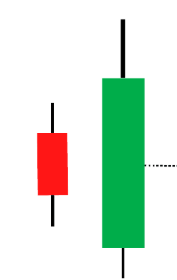
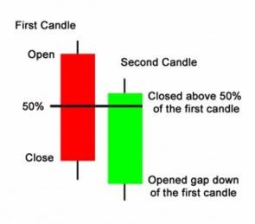
Candlestick Patterns - Part 1
Hammer
Bullish Engulfing
Piercing Pattern

Slide 7

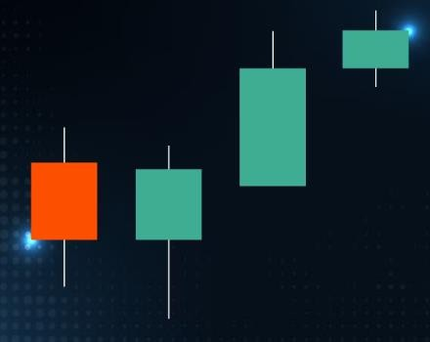
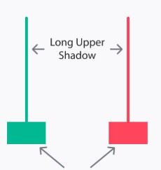
Candlestick Patterns - Part 2
Morning Star
Three White Soldiers
Inverted Hammer

Slide 8
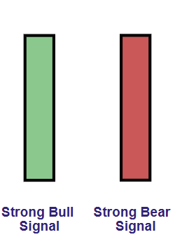
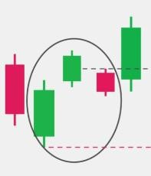
Candlestick Patterns - Part 3
Marubozu
Gap Ups

Slide 9
Market Sentiments & Analyst Ratings
1) Analyst Consensus: Approximately
84.85% of analysts
recommend a 'Buy' rating for Shriram Finance, with an average target price of ₹727.54, suggesting a potential upside of around 9.32% from the current price of ₹677.8.
Technical Indicators: RSI (14): 66.26 – indicating a buy signal. MACD (12,26): 8.57 – suggesting upward momentum.
Moving Averages: All key averages (5-day to 200-day) are signaling a strong buy.
Consolidation Phase: Following a strong upward move, the stock is currently in a consolidation phase, which is typical after significant gains and may precede another upward leg.

Slide 10
Conclusion
In conclusion, Shriram Finance stands out as a robust and dynamic NBFC, delivering inclusive financial solutions across India, especially in underserved rural and semi-urban areas. The company's strong fundamentals, diversified loan portfolio, and customer-centric approach have contributed to its consistent growth. Current market sentiment around the stock is notably bullish, supported by technical indicators like RSI, MACD, and moving averages, as well as recent bullish candlestick patterns. Analyst ratings also reflect optimism, with most recommending a ‘Buy’ stance and projecting upward potential. As Shriram Finance continues to expand and consolidate its market presence, it is well-positioned to benefit from India's growing demand for credit and financial inclusion. Investors and analysts alike view it as a strong contender in the NBFC sector, making it a noteworthy stock for both long-term stability and short-term momentum-driven gains.

